Slide 1


Fouad Atmeh
10-Jan-2024

Slide 2

Outline
Executive Summary
Introduction
Methodology
Results
Conclusion
Appendix

Slide 3
Executive Summary
With space travel becoming more and more affordable, many companies are investing in space travel such as Virgin Galactic, Rocket Lab, Blue Origin and SpaceX.
SpaceX is providing the lowest price for sending an aircraft to the space compared to their competition, where the aim of this report is to try and predict the cost of a SpaceX flight to help with the decision to bid against them or not to bid.
Multiple methodologies where used, where the Decision Tree methodology provided the best results.

Slide 4
Introduction
Project background and context
With space travel becoming more and more affordable, many companies are investing in space travel such as Virgin Galactic, Rocket Lab, Blue Origin and SpaceX.
SpaceX is providing the lowest price for sending an aircraft to the space compared to their competition, where the aim of this report is to try and predict the cost of a SpaceX flight to help with the decision to bid against them or not to bid.
Problems to find answers for:
Since the major cost of the launch is directly relevant to the return of the first stage rocket, we want to understand if it will successfully return or not
What inputs most impact the outcome of the returning of the first stage rocket.

Slide 5

Section 1

Slide 6
Methodology
Executive Summary
Data collection methodology:
Data was collected through the SpaceX API and Wikipedia pages, Details are in the data collection slides.
Perform data wrangling
Data was fairly clean, so little wrangling was done as described in the data wrangling slide.
Perform exploratory data analysis (EDA) using visualization and SQL
Perform interactive visual analytics using Folium and Plotly Dash
Perform predictive analysis using classification models
How to build, tune, evaluate classification models

Slide 7
Data Collection
Data was collected from two sources:
The SpaceX API : This API will give us data about launches, including information about the rocket used, payload delivered, launch specifications, landing specifications, and landing outcome.
Wikipedia’s list of Falcon 9 and Falcon Heavy launches. The other data source for obtaining Falcon 9 Launch historical launch data, collected through web scraping of related Wiki pages.
Data collection from each source is detailed in the following slides.

Slide 8
Data Collection – SpaceX API
SpaceX API contains information about the Launches
We will collect the data from this API, process it, and add it to a Data Frame according to the diagram on the right.
GitHub URL SpaceX API calls notebook: Applied-DS-Capstone/W1-1 jupyter-labs-spacex-data-collection-api.ipynb at main · fouadatmeh/Applied-DS-Capstone · GitHub
Send API Request
Receive JSON Response
Convert JSON to Data Frame
Keep relevant Columns
Clean up the data
Format the data
Filter the relevant data
Fill missing values
Export the data

Slide 9
Data Collection - Scraping
Wikipedia contains historical Launch data
We will collect data from it using Beautiful Soup for web scarping and put it in a data frame
GitHub URL of the web scraping notebook : Applied-DS-Capstone/W1-2 jupyter-labs-webscraping.ipynb at main · fouadatmeh/Applied-DS-Capstone · GitHub
GET HTML Page
Convert it to Beautiful Soup Object
Extract Column Names
Extract the data from the HTML tables
Put the data in a Dictionary
Convert the Dictionary into a Data Frame

Slide 10
Data Wrangling
Some exploratory data analysis was done to understand the data
Since the data is clean, little wrangling was needed as follows:
Simplify the Outcome column to either a 1 or 0
1 for successful landing and 0 for unsuccessful landing
Fill missing PayloadMass values with the mean
GitHub URL of data wrangling notebook: Applied-DS-Capstone/W1-3-labs-jupyter-spacex-Data wrangling.ipynb at main · fouadatmeh/Applied-DS-Capstone · GitHub
Understand the data
List value occurrences of each column
Create a binary landing outcome column
Fill missing data

Slide 11
EDA with Data Visualization
The following charts were plotted, Further Details are in section 2
Flight Number vs Payload Mass
Flight Number vs Launch Site
Payload Mass vs Launch Site
Success Rates of Different Orbits
Flight Number vs Orbit
Payload Mass vs Orbit
Success Rates of different Dates
GitHub URL of EDA visualization notebook:Applied-DS-Capstone/W2-2 jupyter-labs-eda-dataviz.ipynb.jupyterlite.ipynb at main · fouadatmeh/Applied-DS-Capstone · GitHub

Slide 12
EDA with SQL
The following SQL Queries were done on the database to analyze the data, further details are in Section 2:
Display the names of the unique launch sites in the space mission
Display 5 records where launch sites begin with the string 'CCA’
Display the total payload mass carried by boosters launched by NASA (CRS)
Display average payload mass carried by booster version F9 v1.1
List the date when the first successful landing outcome in ground pad was achieved.
List the names of the boosters which have success in drone ship and have payload mass greater than 4000 but less than 6000
List the total number of successful and failure mission outcomes
List the names of the booster versions which have carried the maximum payload mass.
List the records which will display the month names, failure landing_outcomes in drone ship ,booster versions, launch_site for the months in year 2015.
Rank the count of landing outcomes (such as Failure (drone ship) or Success (ground pad)) between the date 2010-06-04 and 2017-03-20, in descending order.
GitHub URL of EDA with SQL notebook: Applied-DS-Capstone/W2-1 jupyter-labs-eda-sql-coursera_sqllite.ipynb at main · fouadatmeh/Applied-DS-Capstone · GitHub

Slide 13
Build an Interactive Map with Folium
I have added the following items to the folium map, for each site location:
Circle around the launch site, with a red color
Popup label for each site, showing the site name
Markers for each launch, with a green color for successful launches, and red color for unsuccessful ones
Lines showing distances from nearest facilities, namely: Coastline, Railroads and Highways.
GitHub URL of interactive map notebook: Applied-DS-Capstone/W3-1 lab_jupyter_launch_site_location.jupyterlite.ipynb at main · fouadatmeh/Applied-DS-Capstone (github.com)

Slide 14
Build a Dashboard with Plotly Dash
We have added two main elements of the dashboard:
Launch records dashboard: showing the success rate for all sites in the form of a pie chart
A selection box allows to drill down per site and see the success rate for each site.
Payload vs Launch outcome: showing the success rate per Payload Mass in the form of a scatter plot
A range slider allows to narrow the payload mass selection by selecting a minimum value and a maximum value.
GitHub URL of the Plotly Dash code: Applied-DS-Capstone/spacex_dash_app.py at main · fouadatmeh/Applied-DS-Capstone (github.com)

Slide 15
Predictive Analysis (Classification)
Multiple classification models were tested, namely:
Logistics Regression
Support Vector Machine
Decision Tree
k Nearest Neighbors
Each model was tested using the following methodology:
Data was split into test and training data
Model was trained using the training data
Multiple hyperparameters were tested, and the one with the best result was selected
The decision Tree model provided the most accurate model.
GitHub URL of predictive analysis Notebook. Applied-DS-Capstone/W4_1 SpaceX_Machine_Learning_Prediction_Part_5.jupyterlite.ipynb

Slide 16
Results
Please check the following slides in Section two for the details of the analysis that was done.

Slide 17

Section 2

Slide 18
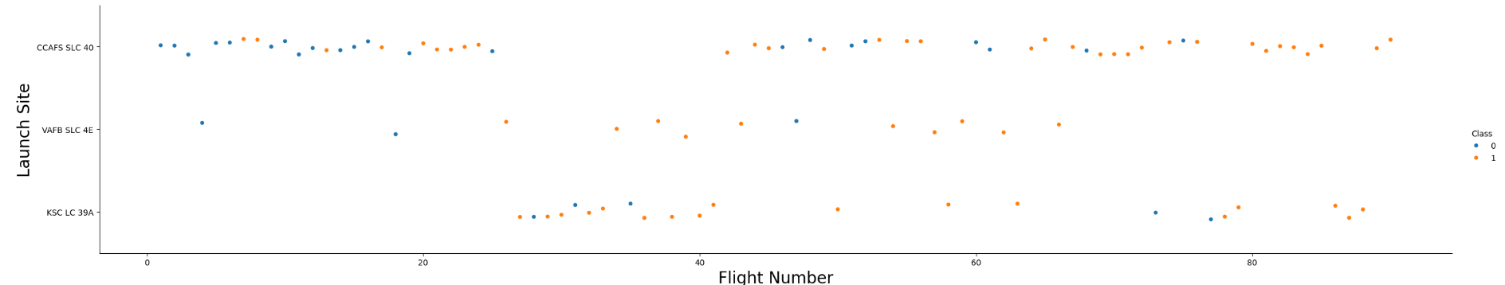
Flight Number vs. Launch Site
Scatter plot comparing Flight Number (represents the continuous launch attempts) vs the Launch Site with success as a color overlay (blue fail and orange success)
Outcomes:
As the flight number increases, the first stage is more likely to land successfully.
Different sites have different success rates

Slide 19
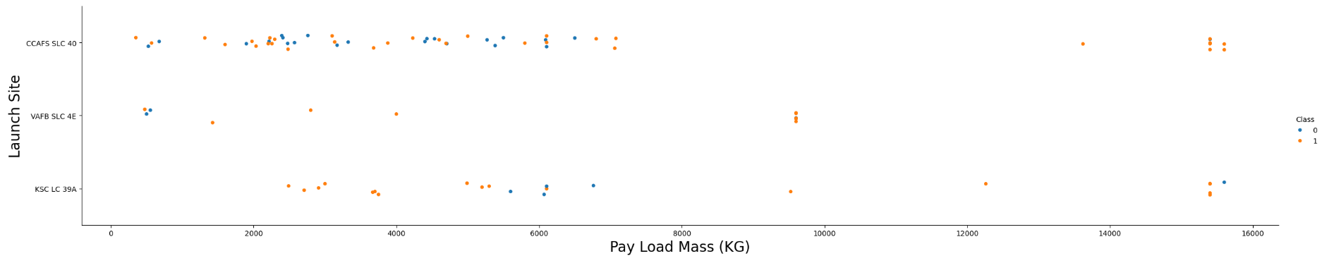
Payload vs. Launch Site
Scatter plot comparing Payload Mass vs the Launch Site with success as a color overlay (blue fail and orange success)
Outcomes:
Some sites don’t launch heavy payloads (greater than 10,000)
Different sites have different success rates

Slide 20
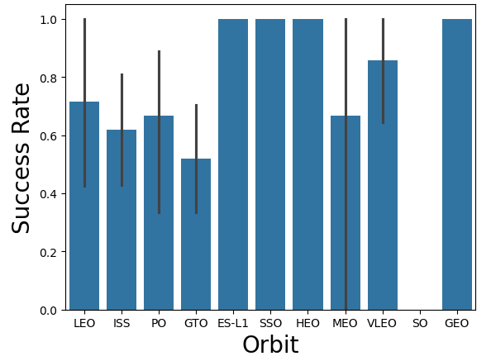
Success Rate vs. Orbit Type
Bar showing Success Rate of Different Orbits
Outcomes:
Different orbits have different success rates
Some orbits have a success rate of nearly 100%

Slide 21
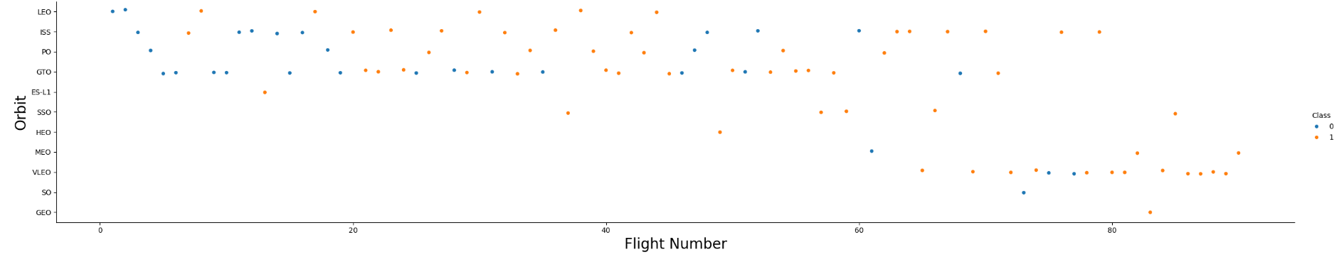
Flight Number vs. Orbit Type
Scatter plot comparing Flight Number (represents the continuous launch attempts) vs the Orbit with success as a color overlay (blue fail and orange success)
Outcomes:
Some orbits like Leo has a success rate related to flights Like LEO
Other orbits don’t seem to have such a relation like GTO orbit.

Slide 22
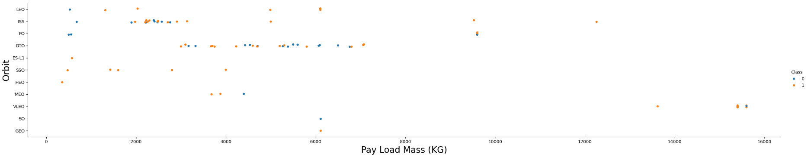
Payload vs. Orbit Type
Scatter plot comparing Payload Mass vs the Orbit with success as a color overlay (blue fail and orange success)
Outcomes:
For some orbits, heavy payloads have higher successful landing rate such as Polar, LEO and ISS.
For other orbits (such as GTO) don’t seem to have such a relation

Slide 23
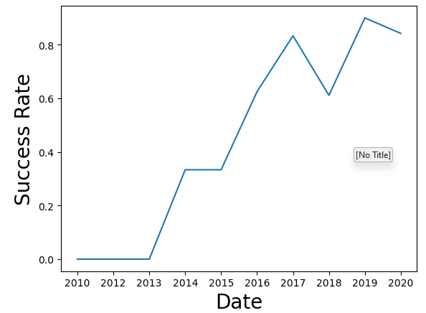
Launch Success Yearly Trend
Line Chart Showing Success Rate of Different Dates
Outcomes:
Success rate since 2013 kept increasing till 2020

Slide 24
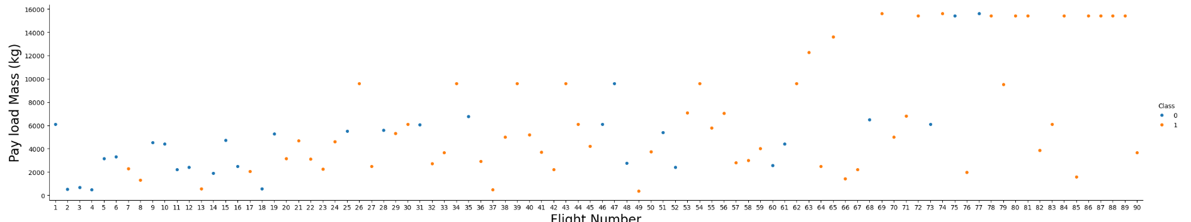
Flight Number vs Payload Mass
Scatter plot comparing Flight Number (represents the continuous launch attempts) vs the Payload with success as a color overlay (blue fail and orange success)
Outcomes:
As the flight number increases, the first stage is more likely to land successfully.
Payload mass is also important; where the higher the payload, the less likely the first stage will return.

Slide 25
All Launch Site Names
The names of the unique launch sites are
The query used is :
%sql SELECT DISTINCT Launch_Site from SPACEXTABLE
Launch_Site
CCAFS LC-40
VAFB SLC-4E
KSC LC-39A
CCAFS SLC-40

Slide 26
Launch Site Names Begin with 'CCA'
Launch_Site
CCAFS LC-40
CCAFS LC-40
CCAFS LC-40
CCAFS LC-40
CCAFS LC-40
Listing first 5 records where launch sites begin with `CCA`
The SQL Query used is:
%sql SELECT Launch_Site from SPACEXTABLE where Launch_Site LIKE 'CCA%' LIMIT 5

Slide 27
Total Payload Mass
The total payload carried by boosters from NASA is:
45596 KG
The SQL Query used is:
%sql SELECT SUM(PAYLOAD_MASS__KG_) from SPACEXTABLE WHERE CUSTOMER="NASA (CRS)"

Slide 28
Average Payload Mass by F9 v1.1
The average payload mass carried by booster version F9 v1.1 is:
2928.4 KG
The SQL Query used is:
%sql SELECT AVG(PAYLOAD_MASS__KG_) from SPACEXTABLE WHERE Booster_Version = "F9 v1.1"

Slide 29
First Successful Ground Landing Date
The date of the first successful landing outcome on ground pad is:
22-12-2015
The SQL Query used is:
%sql SELECT Min(Date) from SPACEXTABLE WHERE Landing_Outcome = 'Success (ground pad)'

Slide 30
Successful Drone Ship Landing with Payload between 4000 and 6000
The names of boosters which have successfully landed on drone ship and had payload mass greater than 4000 but less than 6000
The SQL Query used is:
%sql SELECT Booster_Version from SPACEXTABLE WHERE Landing_Outcome ='Success (drone ship)' and PAYLOAD_MASS__KG_ Between 4000 and 6000
Booster_Version
F9 FT B1022
F9 FT B1026
F9 FT B1021.2
F9 FT B1031.2

Slide 31
Total Number of Successful and Failure Mission Outcomes
The total number of successful mission outcomes is:
100
The total number of failure mission outcomes is:
1
The SQL Query used are (respectively):
%sql SELECT Count(Mission_Outcome) from SPACEXTABLE WHERE Mission_Outcome!='Failure (in flight)’
%sql SELECT Count(Mission_Outcome) from SPACEXTABLE WHERE Mission_Outcome='Failure (in flight)'

Slide 32
Boosters Carried Maximum Payload
The names of the booster which have carried the maximum payload mass is:
The SQL Query used is:
%sql SELECT Booster_Version from SPACEXTABLE WHERE Booster_Version=(SELECT MAX(Booster_Version) from SPACEXTABLE )
Booster_Version
F9 v1.1 B1018

Slide 33
2015 Launch Records
List the failed landing_outcomes in drone ship, their booster versions, and launch site names for in year 2015
The SQL Query used is:
%sql SELECT substr(Date, 6,2),Landing_Outcome, Booster_Version, Launch_Site FROM SPACEXTABLE WHERE Landing_Outcome ='Failure (drone ship)' and substr(Date,0,5)='2015'
substr(Date, 6,2) | Landing_Outcome | Booster_Version | Launch_Site
01 | Failure (drone ship) | F9 v1.1 B1012 | CCAFS LC-40
04 | Failure (drone ship) | F9 v1.1 B1015 | CCAFS LC-40

Slide 34
Rank Landing Outcomes Between 2010-06-04 and 2017-03-20
Date | Landing_Outcome | count(Landing_Outcome)
2012-05-22 | No attempt | 10
2016-04-08 | Success (drone ship) | 5
2015-01-10 | Failure (drone ship) | 5
2015-12-22 | Success (ground pad) | 3
2014-04-18 | Controlled (ocean) | 3
2013-09-29 | Uncontrolled (ocean) | 2
2010-06-04 | Failure (parachute) | 2
2015-06-28 | Precluded (drone ship) | 1
Rank of the count of landing outcomes (such as Failure (drone ship) or Success (ground pad)) between the date 2010-06-04 and 2017-03-20, in descending order:
The SQL Query used is:
%sql SELECT Date, Landing_Outcome, count(Landing_Outcome) from SPACEXTABLE \
WHERE Date BETWEEN '2010-06-04' and '2017-03-20' \
GROUP BY Landing_Outcome \
ORDER by count(Landing_Outcome) DESC

Slide 35

Section 3

Slide 36
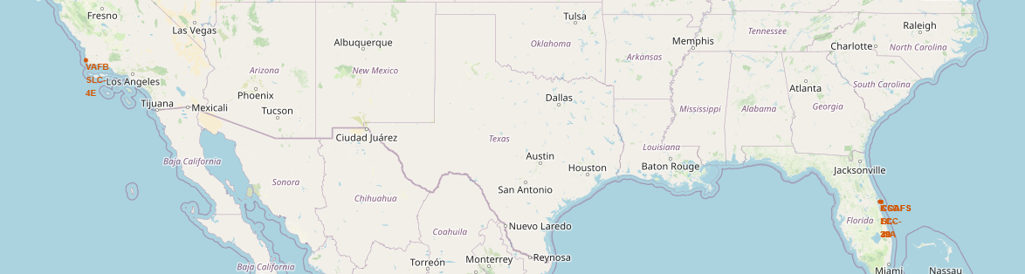
Launch Site Locations
Following map shows all the launch site locations on the map
We see that:
all the launch sites are in the US
They are near the coastline (east and west)

Slide 37
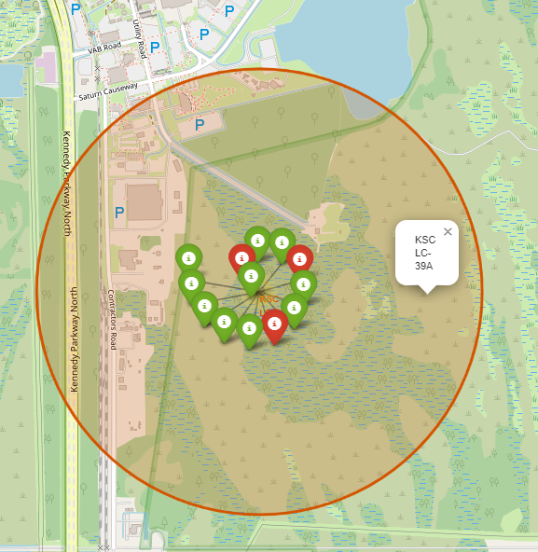
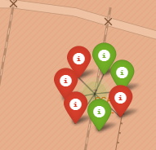
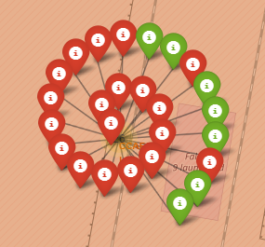
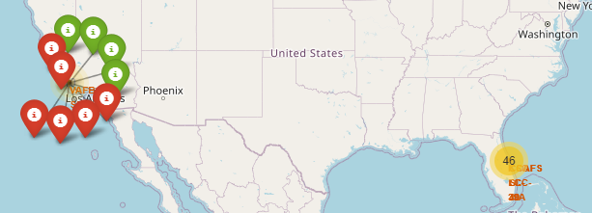
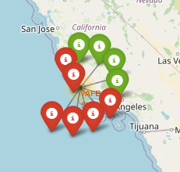
Launch Outcomes per Site
We can see the different launch outcomes of each site by clicking on it as see below
We can zoom in to the details of 4 launch sites

Slide 38
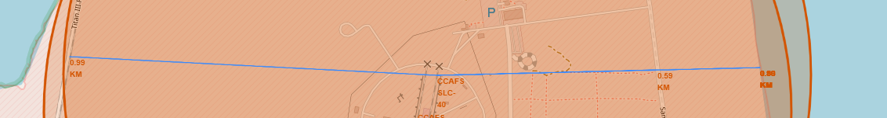
Distance to Coastline, Railway, and Highway
Each launch site requires some facilities to be nearby such as Coastline, Railways and Highways.
We explored the CCAFS SLC-40 site and found the following distances:
Coastline: 0.88 KM
Highway: 0.59 KM
Railway: 0.99 KM

Slide 39

Section 4

Slide 40
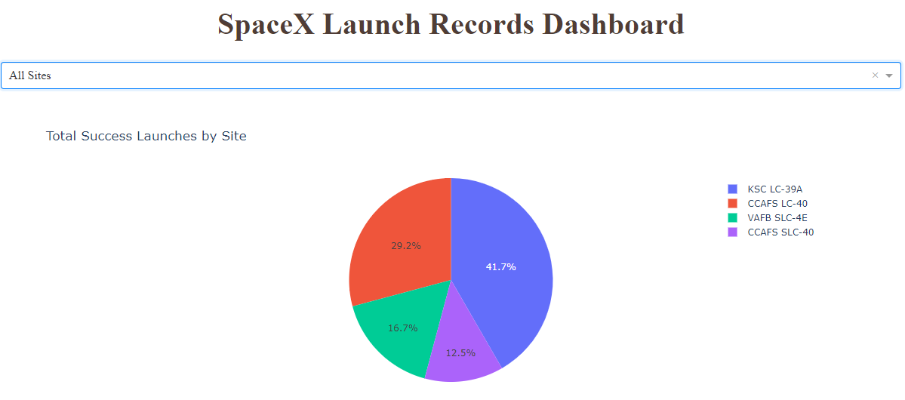
Launch Success Count Chart
Dashboard screen showing success count for each launch site in a piechart

Slide 41
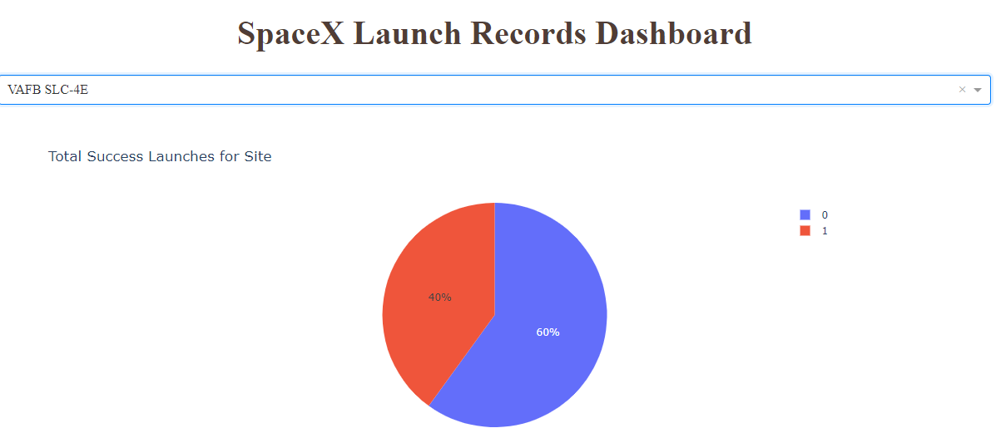
Site with Highest Launch Success Rate
Dashboard screen showing site with hightes launch success rate in a piechart

Slide 42
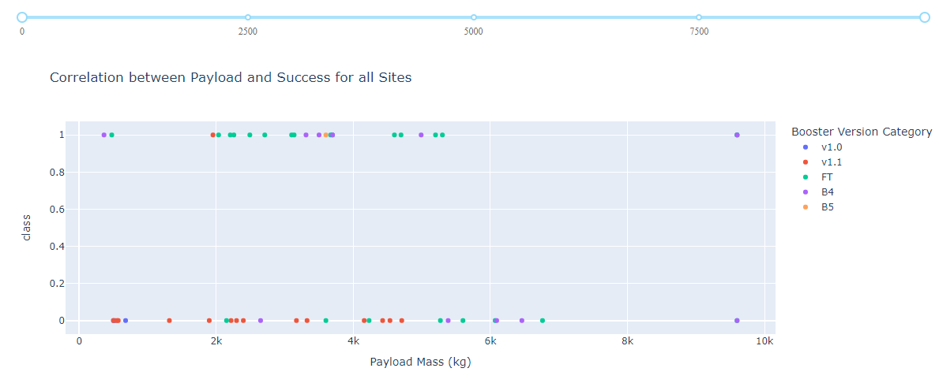
Payload vs Launch Outcome Scatter Plot
Dashboard screen showing Payload vs. Launch Outcome scatter plot for all sites, with full payload range selected in the range slider
The FT booster version has the highest success rate on lower payload masses

Slide 43

Section 5

Slide 44
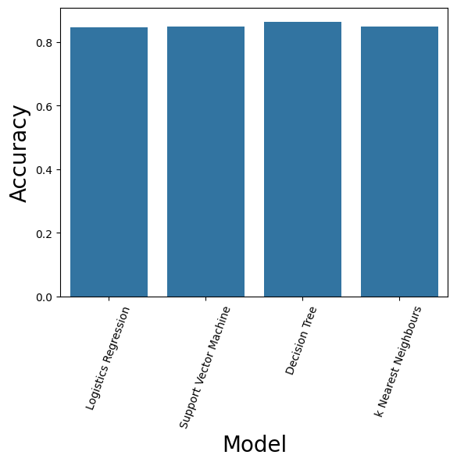
Classification Accuracy
Model accuracy for the various models are plotted on the right
Decision Tree method got the highest accuracy of :
86429%

Slide 45
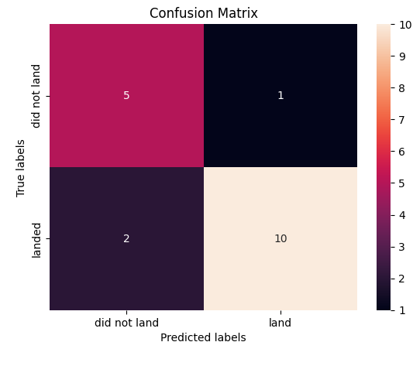
Confusion Matrix
Following is the confusion matrix of the decision tree model

Slide 46
Conclusions
Each classification model provides a different accuracy
The following models were tested:
Logistics Regression
Support Vector Machine
Decision Tree
k Nearest Neighbors
The decision Tree model provided the most accurate model.

Slide 47
Appendix
All code, notebooks and other relevant information are included in the GitHub repository:
Applied-DS-Capstone (github.com)

Slide 48


